Slide 1
RATING PREDICTION PROJECT

Slide 2
PROBLEM STATEMENT:
We have a client who has a website where people write different reviews for technical products. Now they are adding a new feature to their website i.e. The reviewer will have to add stars(rating) as well with the review. The rating is out 5 stars and it only has 5 options available 1 star, 2 stars, 3 stars, 4 stars, 5 stars. Now they want to predict ratings for the reviews which were written in the past and they don’t have a rating. So, we have to build an application which can predict the rating by seeing the review.

Slide 3
UNDERSTANDING:
We all know ratings and reviews are important. While they’ve only been around for about two decades, it’s hard to imagine shopping without them. According to consumer research we conducted of 30,000+ global shopping, the majority (88%) of shopping use reviews to discover and evaluate products and on based on these the customers easy to find things. The ability to successfully decide whether a review will be helpful to other customers and thus give the product more exposure is vital to companies that support these reviews, e-commercial sites like Amazon, Flipkart, Snapdeal, etc. In this research project, show a new approach to enhance the accuracy of the rating prediction by using machine learning methods the training performance of our model changes as we change the training method, the dataset used for training and the features used in the model. It help to build an application which can predict the rating by seeing the review.

Slide 4
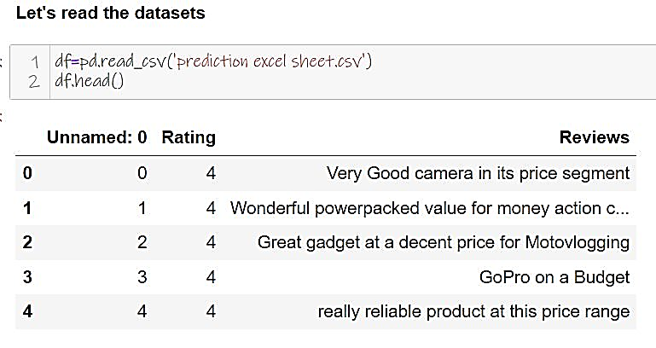
EDA STEPS AND VISUALIZATIONS:
1. Data Collection

Slide 5
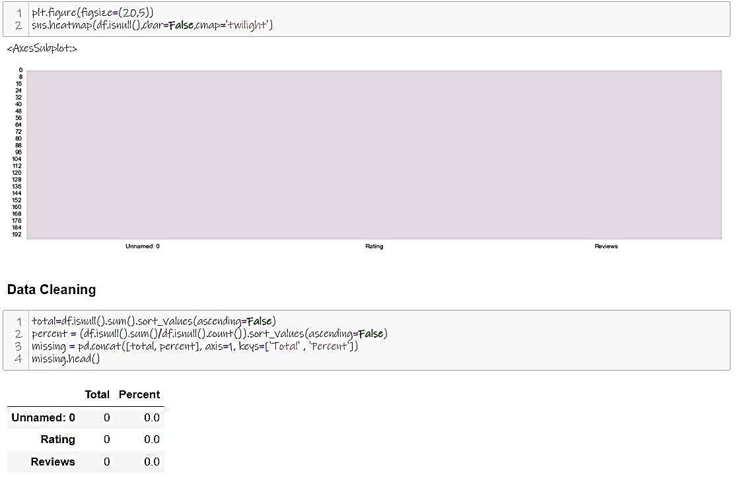
2. Data Cleaning

Slide 6
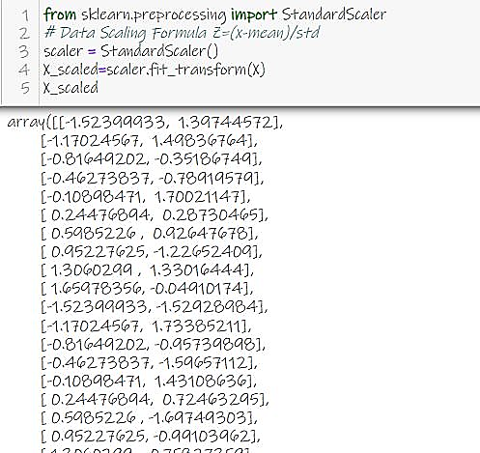
3. Univariate Analysis

Slide 7
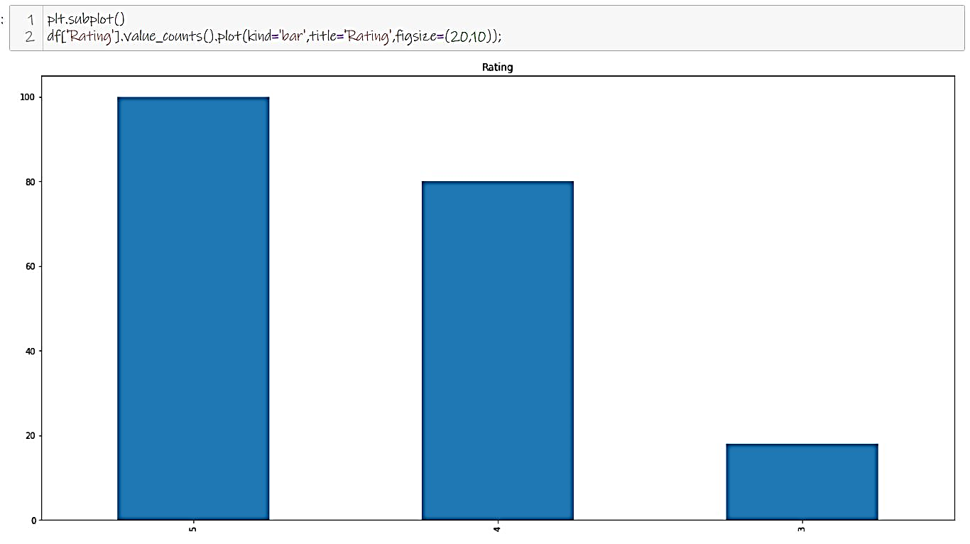

Slide 8
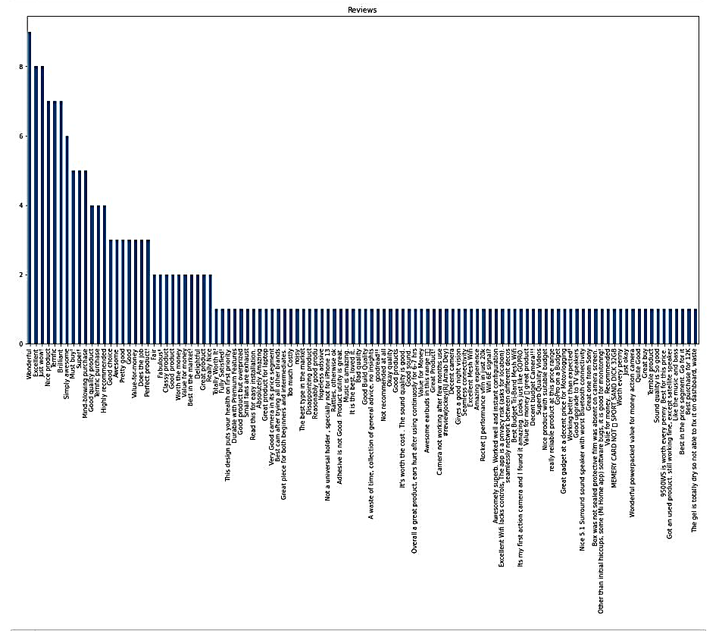

Slide 9
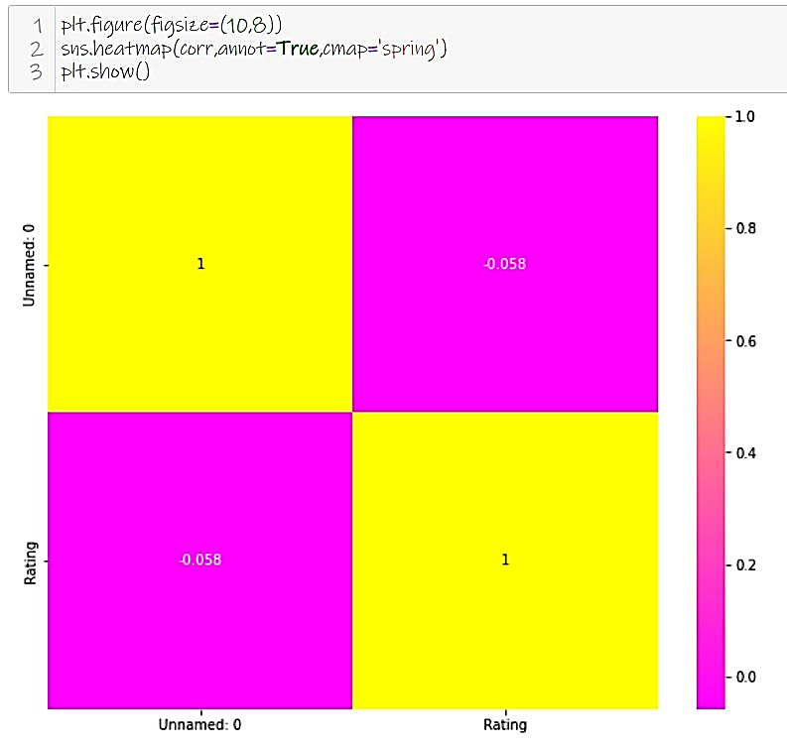
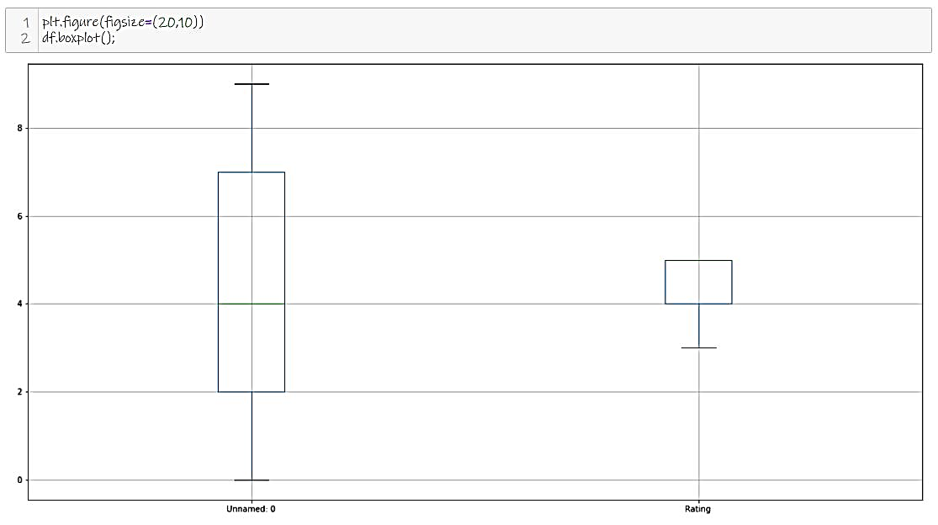

Slide 10
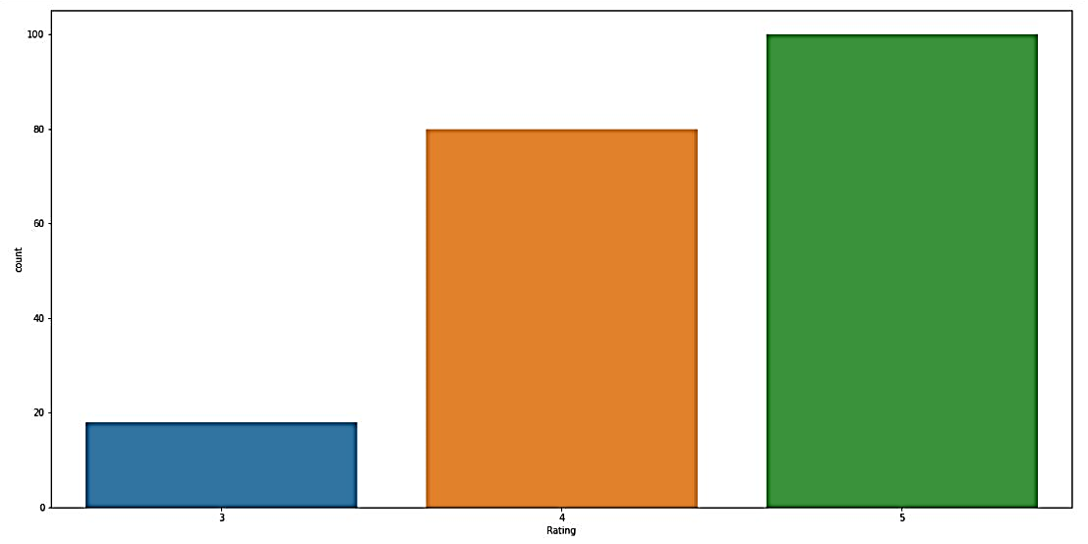
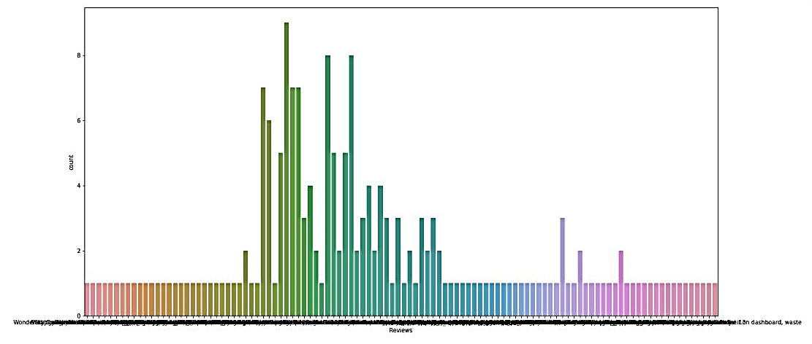

Slide 11
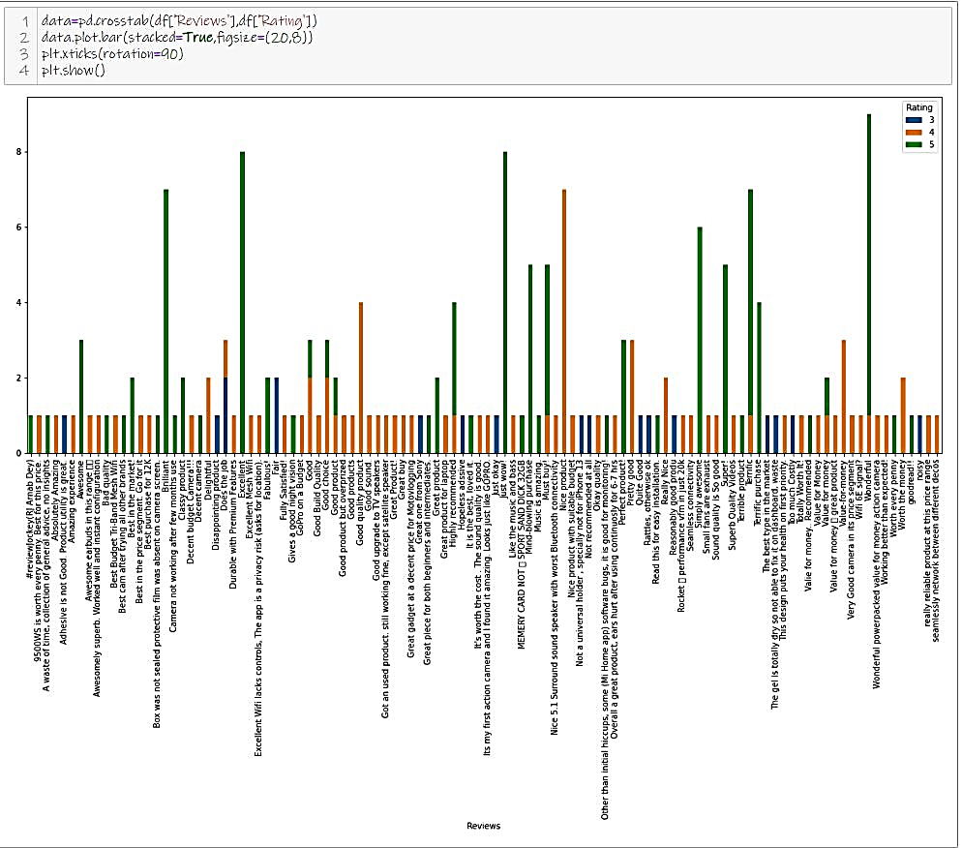

Slide 12
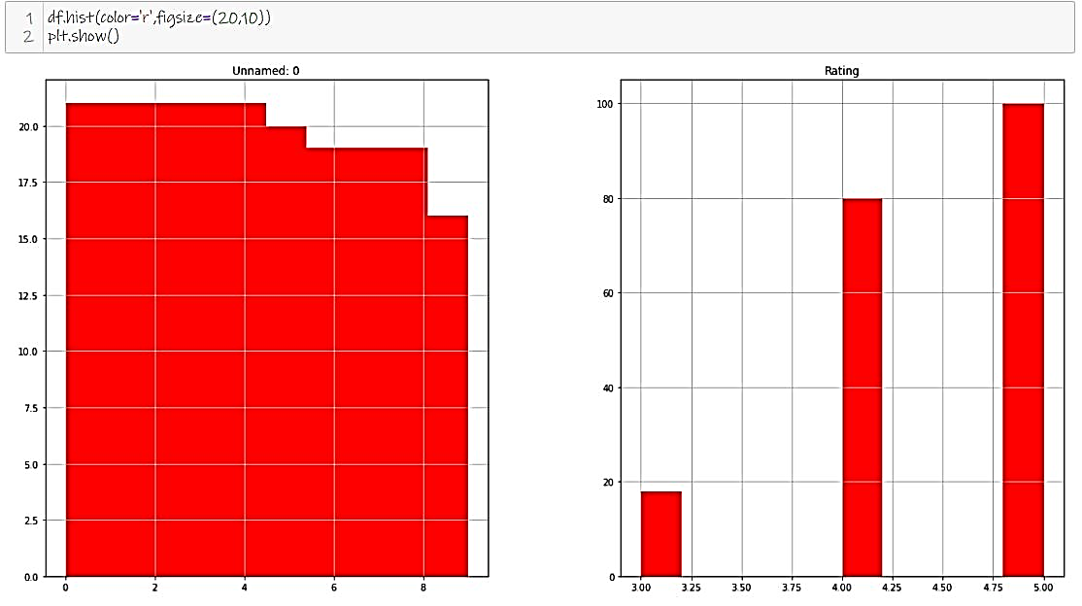
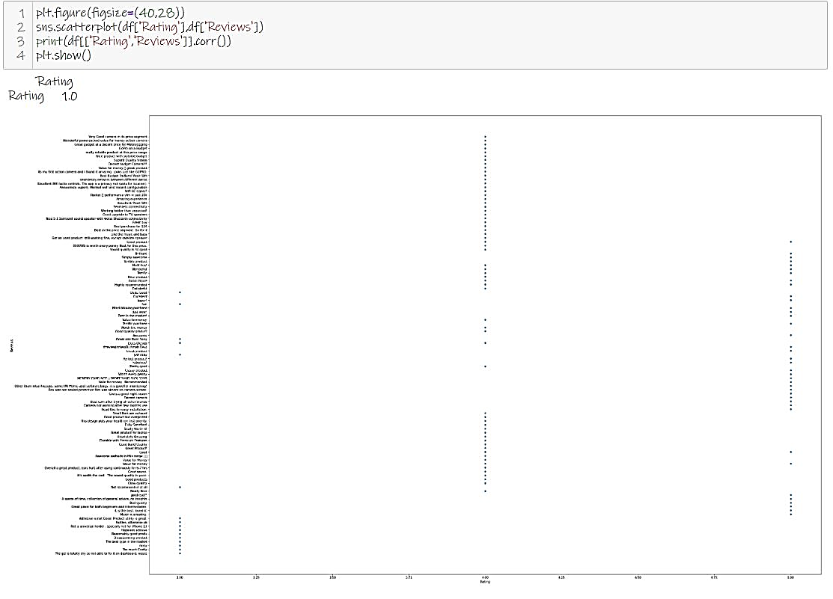
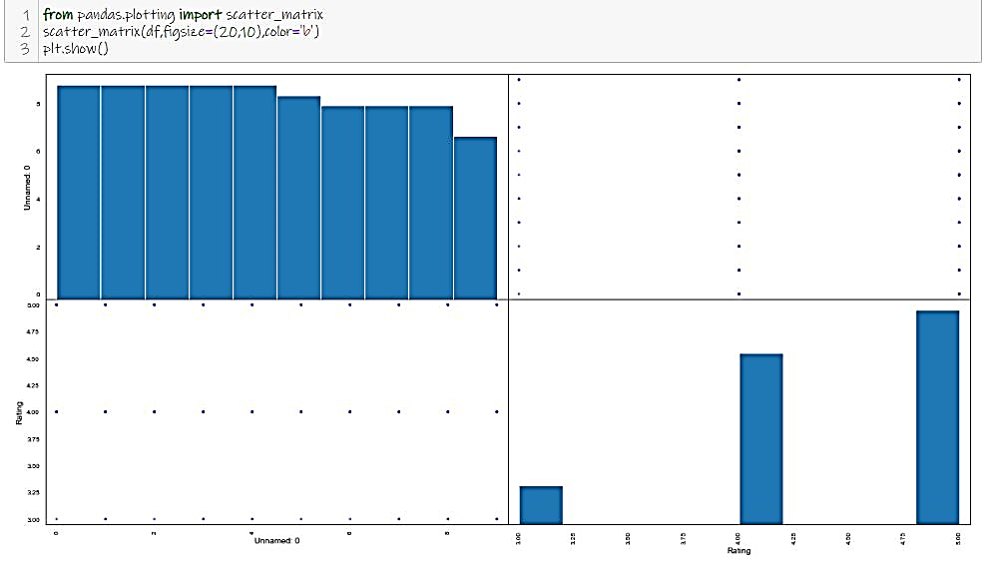
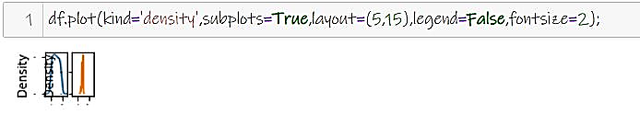

Slide 13
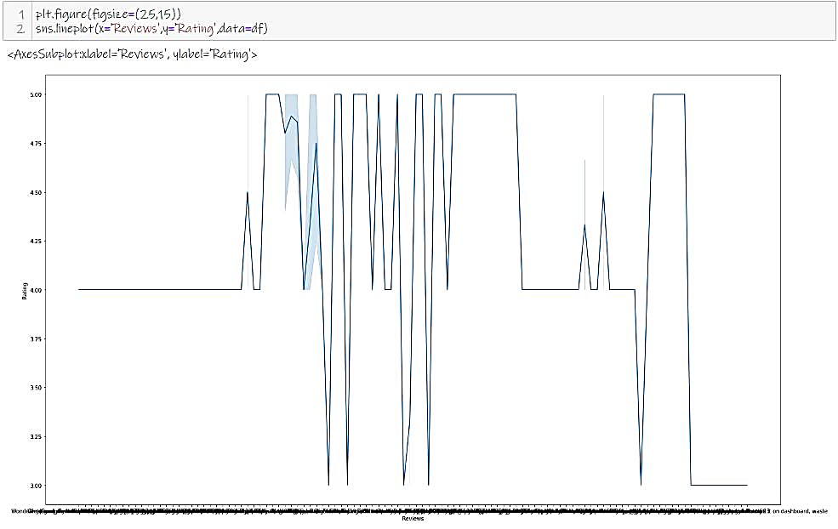
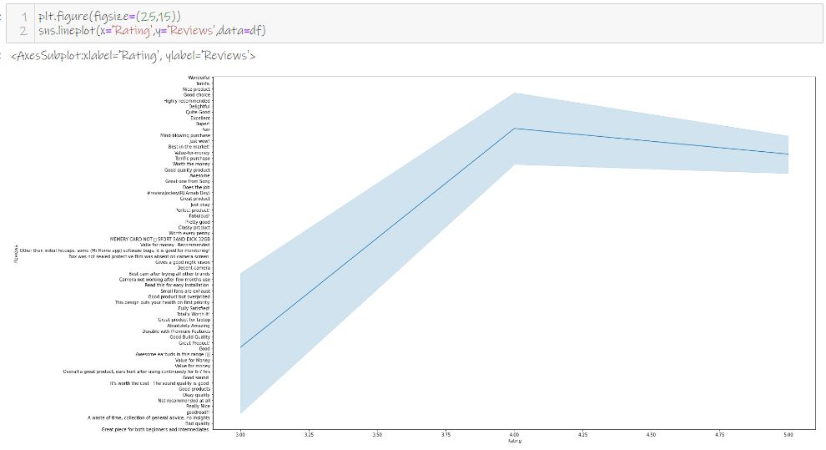

Slide 14
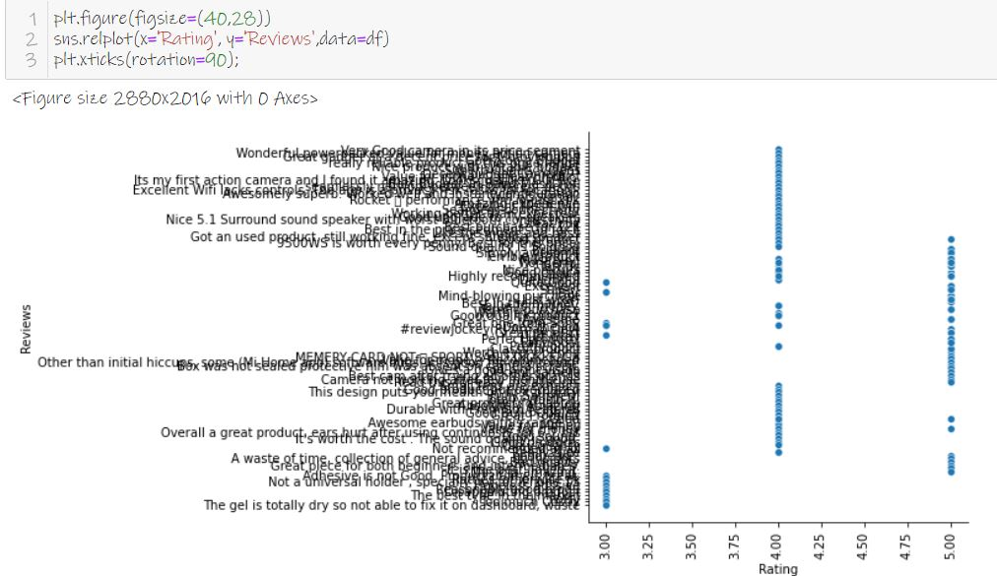
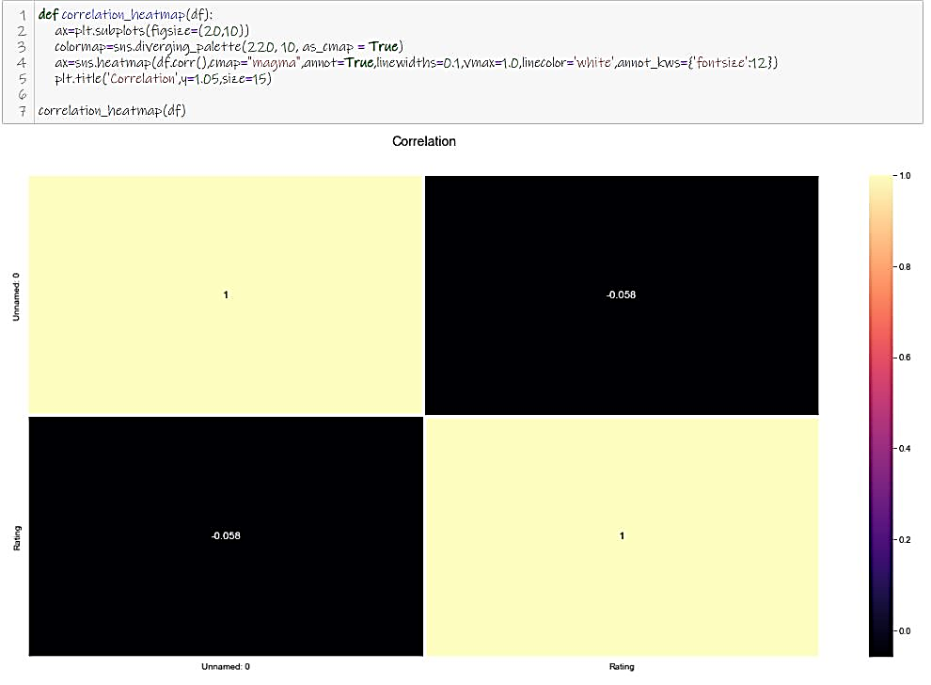

Slide 15
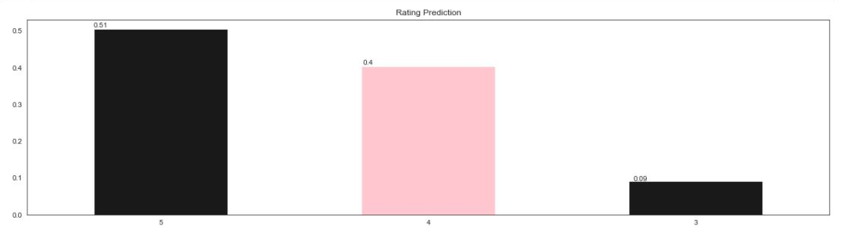
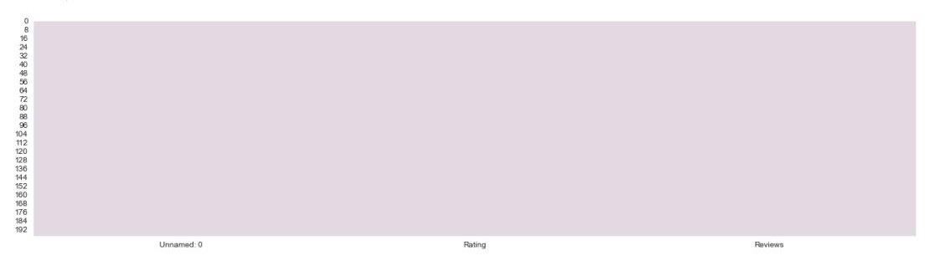

Slide 16
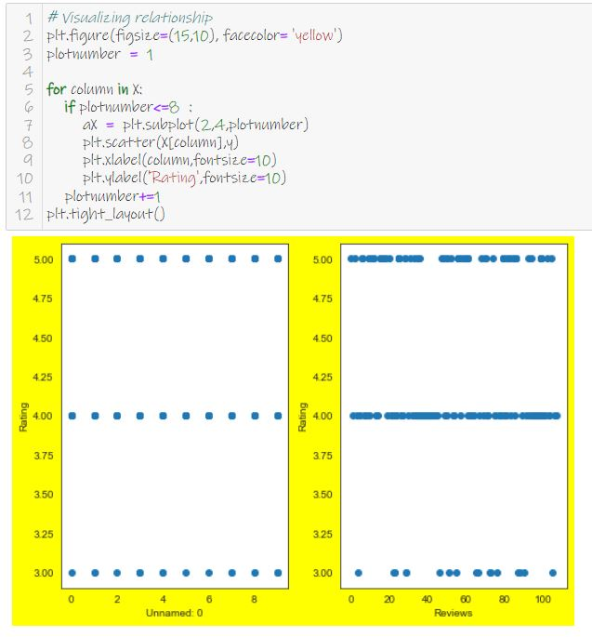
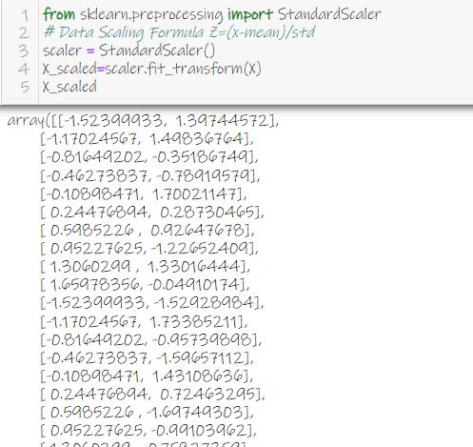
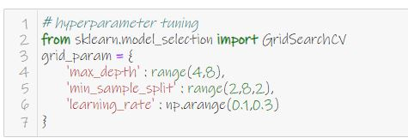
VISUALIZING THE RELATIONSHIP WITH RATING

Slide 17
STEPS AND ASSUMPTIONS TO COMPLETE THE PROJECT:
1. The purpose of this case is to understand the rise of e-commerce which brought a significant rise in the importance of customer reviews and evaluate used to predict rating and to develop a strategy that utilizes data mining techniques towards ratings prediction.
2. There are two main methods to approach this problem. The first one is based on review text content analysis and uses the principles of natural language process (the NLP method). This method lacks the insights that can be drawn from the relationship between costumers and items.
3. The model of the independent variables and dependent variables are exactly vary with the variables.
4. It can accordingly manipulating the strategy of the areas that will yield high returns as it make easier for the clients.
5. By visualizations there are many things to be noted when it will according to work each other
6. By preprocessing the data it means that from the help of label encoder helps the dataset column to transform to fit another column in to it.

Slide 18
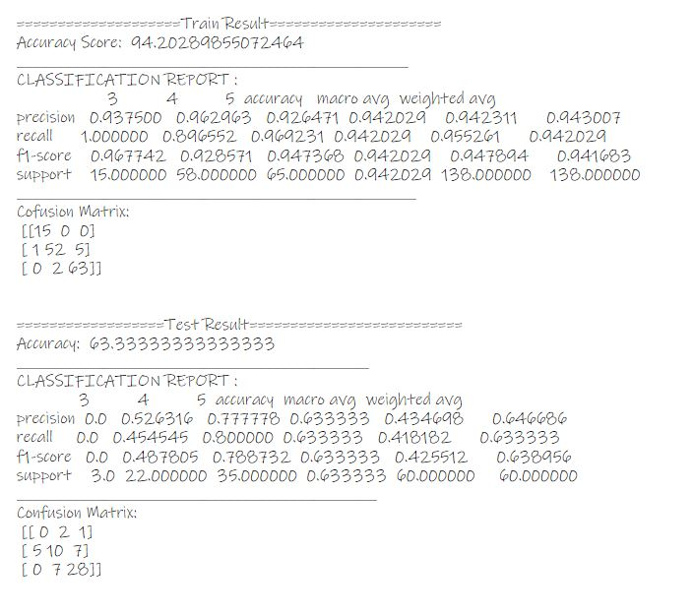
FINALIZED MODEL:
Accuracy score:
Train Result : 94.2%
Test Result : 63.3%

Slide 19
CONCLUSION
In conclusion, combining the formerly know data about each user’ similarity to other users with the sentiment analysis of the rating and reviews itself, does help to improve the model prediction of rate the user’s review, will get the purpose.

Slide 20
THANK YOU

